Slide 1

UK Mini sumo @ Fizzpop
Ladder league and a once a Month knockout cup

Slide 2
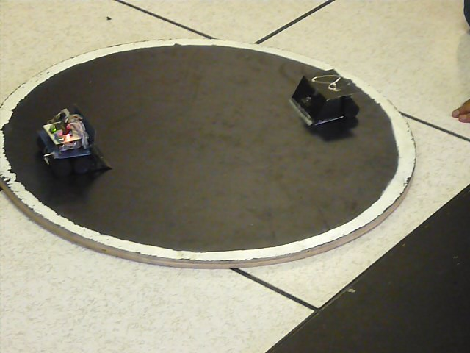

Slide 3
Robots Regulations
Robots must comply to the following regulations:
Fit within a 10cm cubed area
Weigh in no heavier than 500 grams
Fully Automated using computer or Microcontroller technology
Have a family friendly name (All robots must be named)
Battery power should be 9 volts maximum using any battery technology.
Cause damage to other robots or the area (Dohyo)

Slide 4
Bout Regulations
Each bout will be a timed round of 3 minutes long
Each robot should be placed in its start line and be ready to go when the start signal is given
Each bout is the best of three rounds the winner of which shall be the robot with the 2 points
Referees decisions are final, of which there will be at least 2 over seeing play
Robots deemed to be breaking the regulations will forfeit the bout

Slide 5
Competitor Behaviour
Competitors will at all times show respect to everyone including referees and other competitors
Competitors will be required to keep any banter to a family friendly manor
Any competitor deemed to be breaking the above shall be so warned with a yellow card, should such behaviour continue the referees shall show a red card and the bout shall be awarded to the other robot

Slide 6
What is a ladder league?
A Ladder league is a list of competitors and to move up the list you challenge the person above you but just as you can challenge so can others challenge you
You can only be challenged by the person in the spot below you and you can only challenge the person in the spot above you, for example if you are 10th on the list you can only challenge for 9th spot and you can only be challenged by 11th no lower

Slide 7
More Information
http://www.er-online.co.uk/minisumo/wiki/TournamentRules
http://minisumo.org.uk/
http://github.com/fizzPOPmakerspace/RobotMiniSumo

